Slide 1

Challenge & Proposed Solution
Modern portfolio management demands real-time risk visibility across hundreds of assets.
The Challenge
Our Solution
• Manual risk assessment can't scale to large portfolios
• Automated 4-stage pipeline ingests live market data
• Delayed market data leads to stale risk signals
• ML-driven anomaly detection flags hidden risks
• Siloed analysis: price, sentiment, news reviewed separately
• NLP sentiment analysis on real-time financial news
• No unified view of cross-asset risk exposure
• Interactive dashboard with drill-down to any asset
Key Value Proposition
• Analyze up to 500 assets from a universe of 1,074 US stocks in a single run
• Delta-based caching reduces redundant API calls by up to 90%
• Traffic-light risk ratings (RED / YELLOW / GREEN) enable instant prioritization
1 / 7

Slide 2
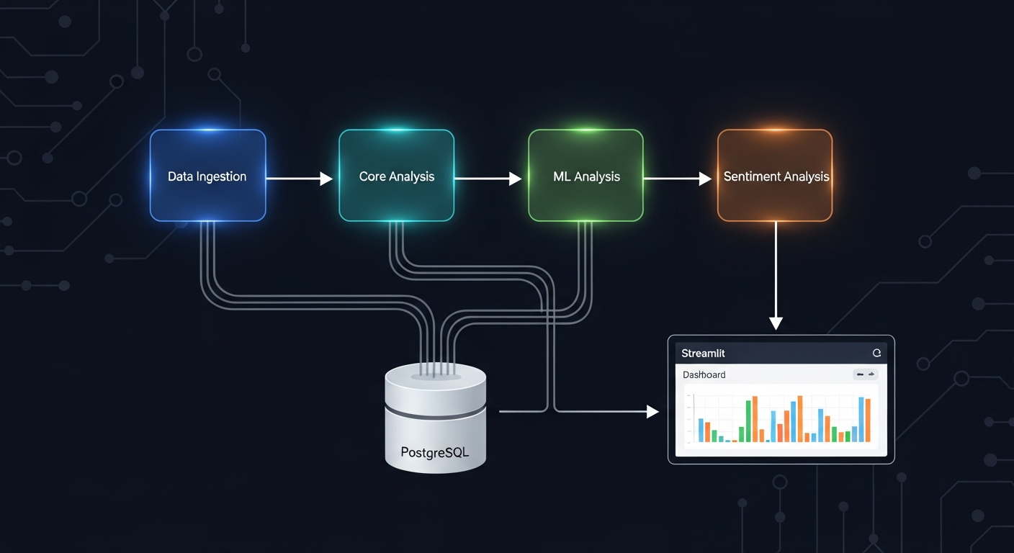
System Architecture Overview
1
Data Ingestion
Yahoo Finance API Delta caching 1,074 tickers
2
Core Analysis
Volatility & drawdown Risk flag assignment Sharpe & momentum
3
ML Analysis
Isolation Forest Gradient Boosting Anomaly detection
4
Sentiment
PostgreSQL
Streamlit
scikit-learn
Live news fetch TextBlob NLP Headline scoring
Yahoo Finance
Persistent storage & caching
Interactive 5-tab dashboard
ML models & predictions
Real-time prices & news
2 / 7

Slide 3

Technical Implementation Details
Data Ingestion Engine
ML & Sentiment Pipeline
• yfinance API for real-time stock prices
• Isolation Forest anomaly detection
• 6-month historical price window
• Gradient Boosting risk classifier
• Company metadata extraction (sector, cap, PE)
• Feature importance extraction (Key Risk Drivers)
• Batch processing with progress tracking
• TextBlob polarity scoring on headlines
• Delta caching: only fetch new dates per symbol
• Live Yahoo Finance news (2-day window)
• ~1,074 ticker universe (S&P 500+)
• Targeted analysis for RED-flagged assets
Core Risk Analysis
Technology Stack & Optimizations
• Annualized volatility calculation
• Python 3.11 | Streamlit | pandas / NumPy
• Maximum drawdown from peak measurement
• scikit-learn (Isolation Forest, Gradient Boosting)
• Volume trend analysis (30-day window)
• Plotly interactive charts | Matplotlib static charts
• Configurable RED / YELLOW thresholds
• PostgreSQL + psycopg2 (persistence & caching)
• Sharpe ratio & momentum scoring
• Delta caching cuts API calls by up to 90%
• Multi-factor risk flag assignment
• Browser timezone auto-detection
3 / 7

Slide 4
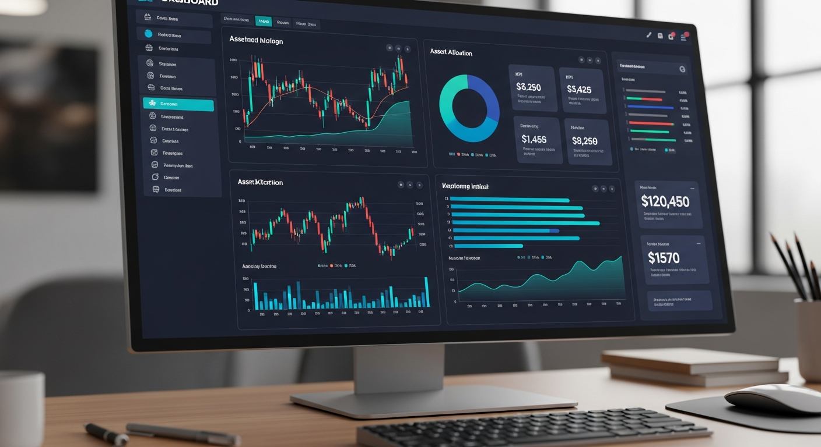
Dashboard Features
1
Overview
KPI strip, sector allocation, risk distribution, ML Summary, on-demand PDF/CSV reports
2
Risk & Sentiment
Recommendations, flagged assets with news cards, sentiment polarity breakdown
3
Asset Deep Dive
Type-ahead search, per-asset risk flags, historical prices, ML anomaly overlay
Market News
Interactive Dashboard Preview
4
Live RSS from 5 major outlets, auto- categorized, sentiment-scored, filterable
Additional Capabilities
• Dark / Light mode toggle
5
Metrics & Thresholds
• Save & reload runs from cloud storage
Methodology docs, cache stats, performance metrics, threshold config
• Configurable risk thresholds via sidebar
• Browser timezone auto-detection
4 / 7

Slide 5

Live Demo
Financial Risk Intelligence Dashboard
1
Configure
Set portfolio size and risk thresholds
2
Execute
Run the 4-stage analysis pipeline
3
Explore
Navigate interactive tabs and drill-downs
4
Report
Generate PDF/CSV risk reports on demand
5 / 7

Slide 6

Production Readiness & Industry Impact
Production Ready
Scalability
Security & Reliability
• Cloud-deployed on Replit infrastructure
• Delta caching scales to thousands of symbols
• Environment variable secrets management
• PostgreSQL persistence for all data
• Modular pipeline stages run independently
• Database connection pooling
• Error handling with graceful fallbacks
• Expandable stock universe architecture
• Input validation on all parameters
• Sanitized data serialization (Inf/NaN)
• JSONB storage for flexible schema evolution
• Graceful handling of API failures
• Configurable parameters via UI
• Batch processing with progress tracking
• Data integrity with UNIQUE constraints
• Session state management
• Stateless dashboard, persistent backend
• Automated checkpoint & rollback
Industry Impact
Future Roadmap
• Democratizes institutional-grade risk analytics
• Real-time streaming data integration
• Reduces portfolio review time from hours to minutes
• Custom portfolio upload (CSV / API)
• Bridges gap between quant analysis and business users
• Multi-user access with role-based permissions
• Combines price, ML, and sentiment signals in one view
• Extended ML models (LSTM, transformer-based)
• Actionable recommendations, not just raw data
• Automated alert system (email / Slack)
6 / 7

Slide 7

Questions & Answers
Thank you for your attention
Financial Risk Intelligence
7 / 7

